Slide 1


Recommendations for AI Practices
Danish Association of Consulting Engineers & Danish Association of Architectural Firms

Slide 2


Introduction
AI assistants have quickly become a part of everyday life, and it seems they will become a central part of work life in the future. The use of AI in companies offers many opportunities – but also a number of challenges.
To a large extent, the use of AI is about common sense, and employees can see through most pitfalls. At the company level, it is about balancing the opportunities with the risks that AI also entails.
The use of AI should particularly prompt each company to consider the risks related to GDPR and copyright. We therefore urge each member to set a basic framework for how employees should use AI.
We have developed the following set of recommendations that can serve as inspiration for how each company can set the framework for the internal use of AI.
Most companies are already using the technology, and it is only going one way. There are many benefits to be gained from using AI. As a company, you just need to consider how you will use it.
All images in this PowerPoint presentation are generated using AI.

Slide 3
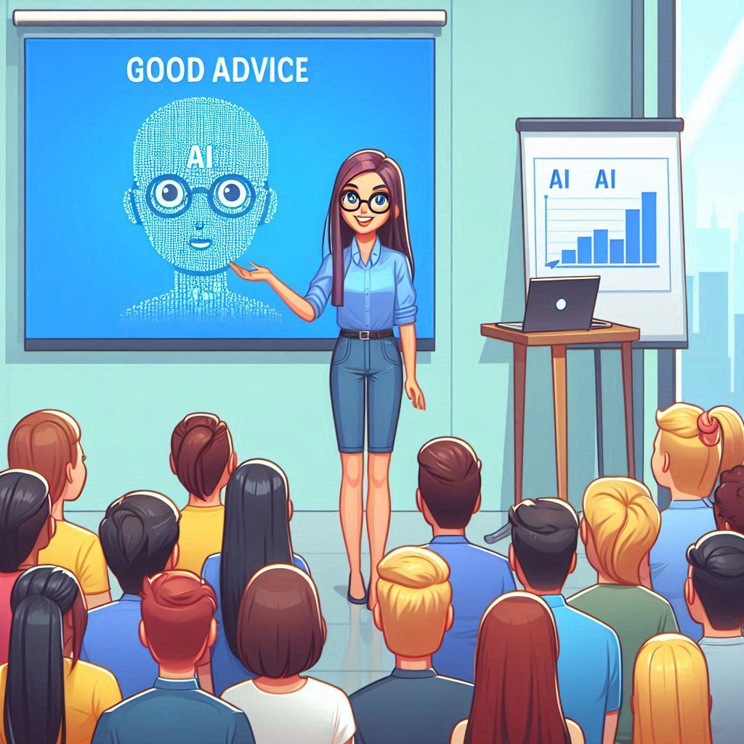
General advice
Think carefully
Review AI assistant output
Be aware of whether you are working in an open or closed system
AI assistants lack basic human quality
If in doubt, seek help

Slide 4

Think carefully
It is your responsibility how you use AI.
As an employee, you should consider where you can best utilize AI in your work. There are certain tasks where it will be more effective than others.
AI assistant outputs can, for example, be used for inspiration or to solve specifik tasks such as brainstorming, translations, calculations and proofreading.

Slide 5

Review AI assistant outputs
The answers generated by AI assistants may contain outdated or incorrect information. The information the answers are based on is not necessarily updated very often.
Outputs from AI assistants will typically be presented convincingly as facts, even though this is not necessarily the case.
As an employee, it is necessary to check if the presented information is reliable.
You can compare it with a Google search, where you would also be critical of the answers.
In your work with AI assistants, it is also a good idea to be aware of any linguistic errors, mathematical errors, translation errors, and more general lack of nuances that can appear in the answers.

Slide 6
Be aware of whether you are working in an open or closed system
If you, as an employee, work in an open system, you should consider the information you provide to the AI assistant as out of your hands.
A good rule of thumb can be to ask yourself if you would be unhappy if some of the material was published on LinkedIn the next day - if you would, you probably shouldn’t work with it in an open system.
If you, as an employee, work in a closed system, the freedom is greater, although the attitude towards what implications a closed system comes with differs from company to company.
Open systems can be used for information retrieval, but you should never provide an AI assistant with information that is only for internal use or intended for limited viewing. This could, for example, be regarding details from a project meeting.
You must be aware of GDPR rules, as you can end up sharing information that constitutes a breach of GDPR, using answers provided by an AI assistant.
You must be particularly aware of copyright rules as a company, as AI assistants can end up disseminating information that contains breaches of others’ copyrights.
It is also relevant to be aware of your own copyright as a company, as employees working in an open system can end up sharing information that can subsequently be used by others.
As a company, you must conduct a risk assessment and subsequently create a policy for open/closed systems.

Slide 7
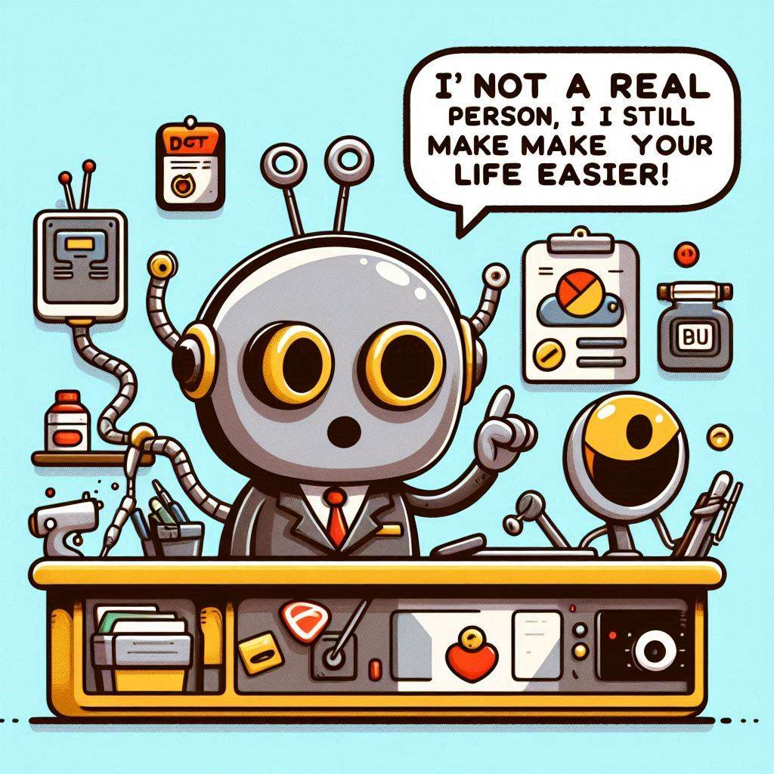
AI assistants lack basic human quality
AI assistants do not possess empathy and do not understand the world.
They are trained on enormous amounts of data, but there is neither human perception nor rationale behind their output.
For the same reason, they do not understand what lies between the lines, and important nuances can be lost in their answers.
It is a self-reinforcing problem, as gradually more content on the internet is formulated by AI assistants.
So, AI assistants can, in principle, be trained on content produced by themselves, thereby opening up even more potential risks.

Slide 8
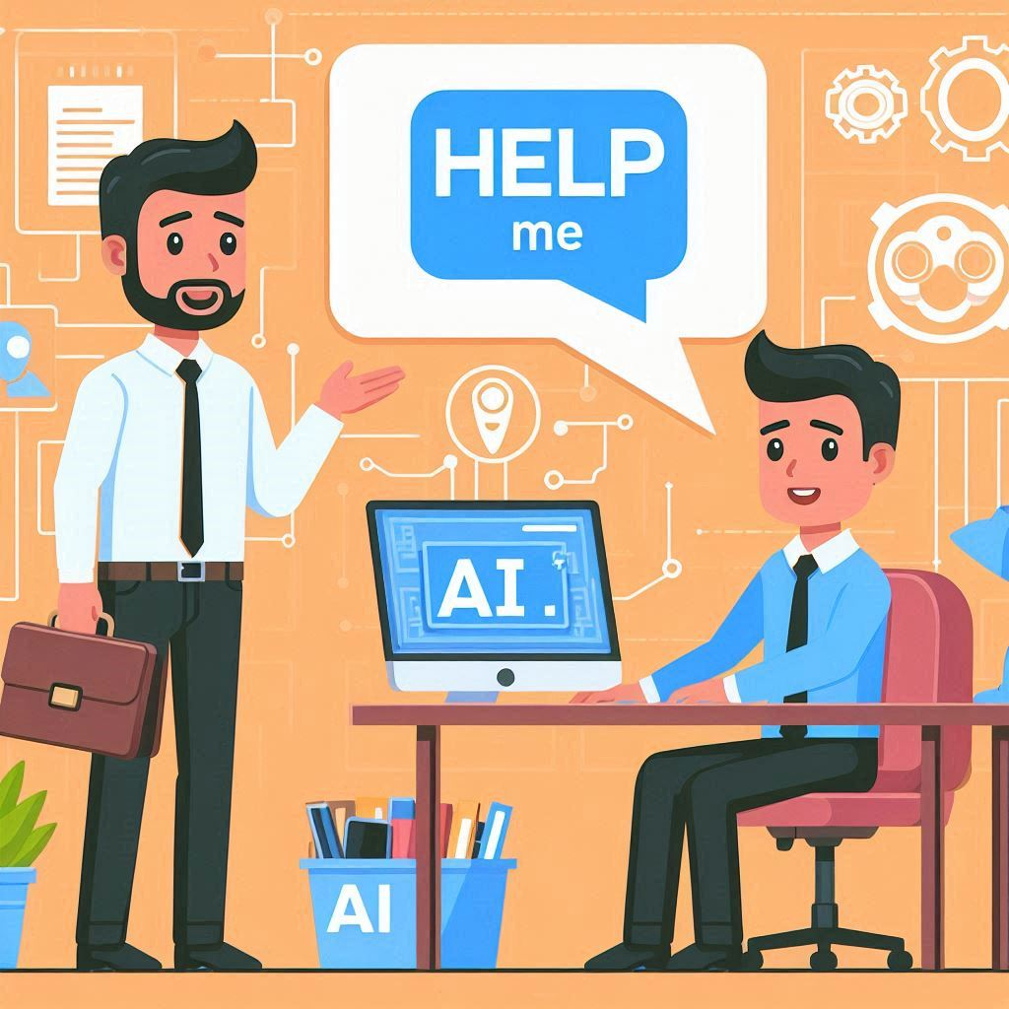
If in doubt, seek help
AI assistants are a fairly new technology that is constantly evolving. Therefore, the correct answer today may be the opposite tomorrow.
As a company, you must decide where you stand on AI-related questions.
As an employee, it is therefore a good idea to consult your company in situations where you are in doubt about something.
Seek help in the company’s knowledge base or ask someone who has knowledge of the topic you have sought clarification on via AI.

